Slide 1


ICIIT 2024
The 2024 9th International Conference on Intelligent Information Technology
Ho Chi Minh City, Viet Nam
Vietnam National University - HCMC
University of Information Technology
ChainSniper: A Machine Learning Approach for Auditing Cross-Chain Smart Contracts
Tuan-Dung Tran
Kiet Anh Vo
Phan The Duy
Nguyen Tan Cam
Van-Hau Pham

Slide 2
Table of content
01
02
Introduction
Proposed system
03
04
Implementation
Conclusion

Slide 3
Introduction
Section 01

Slide 4
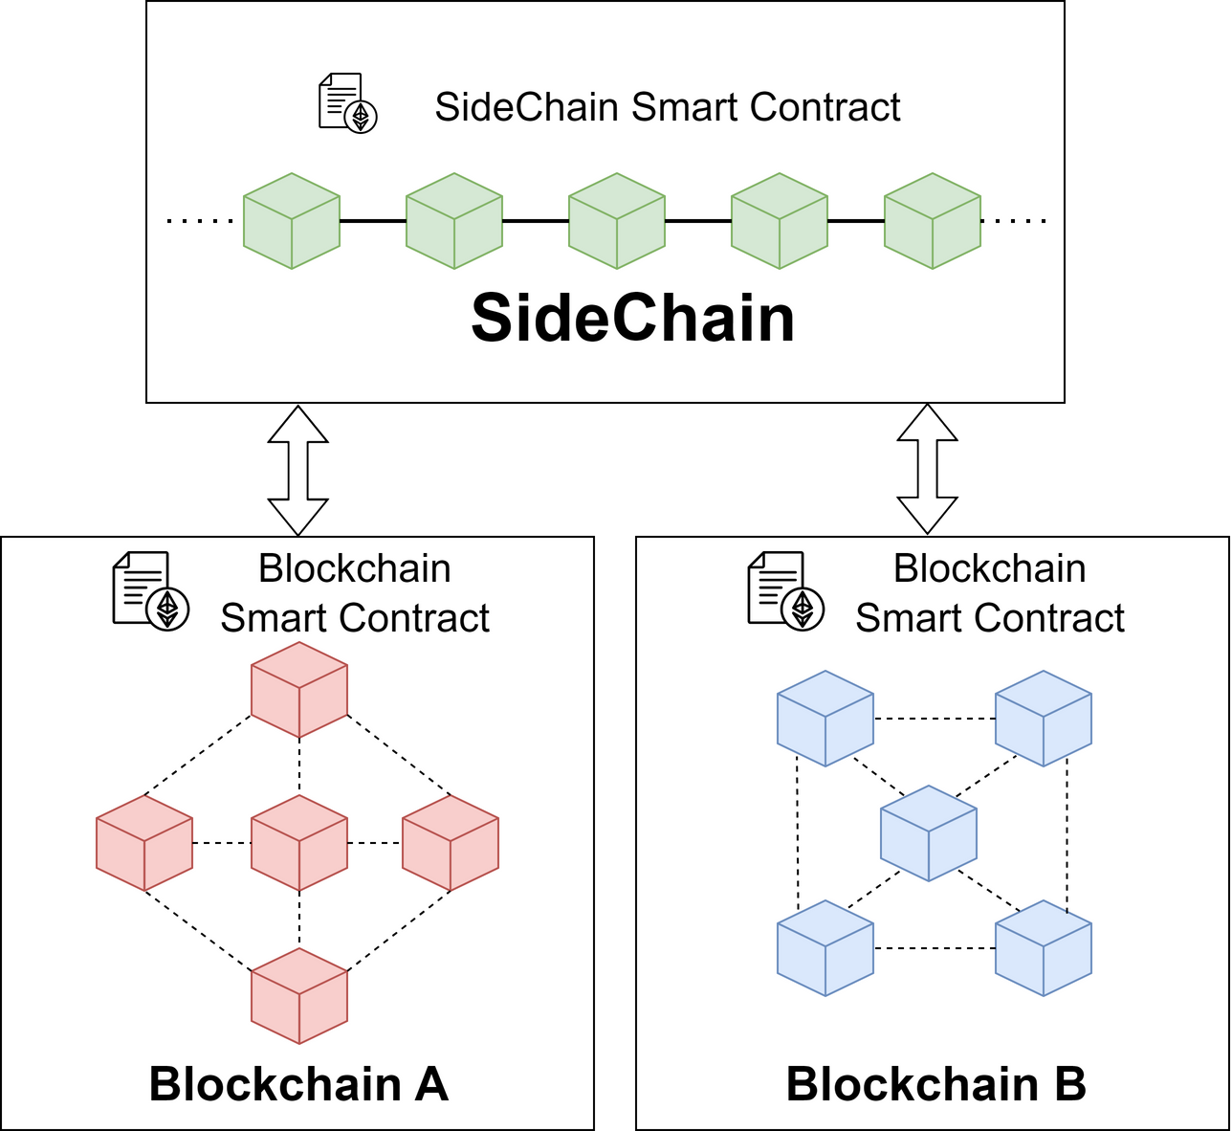
SideChain

Slide 5
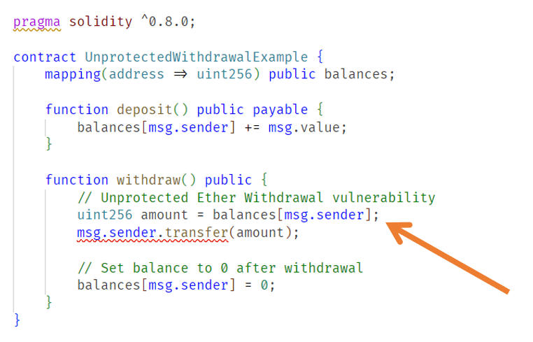
Vulnerability in SideChain Smart Contract

Slide 6
Solution
Create the ChainSniper system for logging, scanning, and monitoring
Generate the dataset CrossChainSentinel consisting of 300 manually labeled smart contract samples.
Implement and evaluate various machine learning models based to accurately detect malicious contracts

Slide 7
Proposed system
Section 02

Slide 8
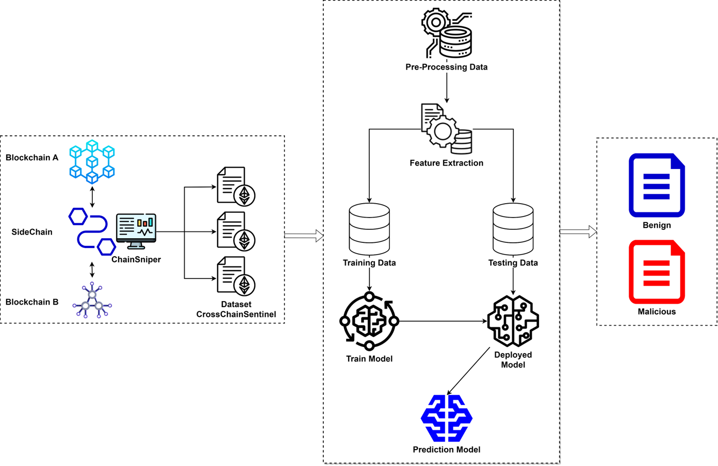
Overview diagram

Slide 9
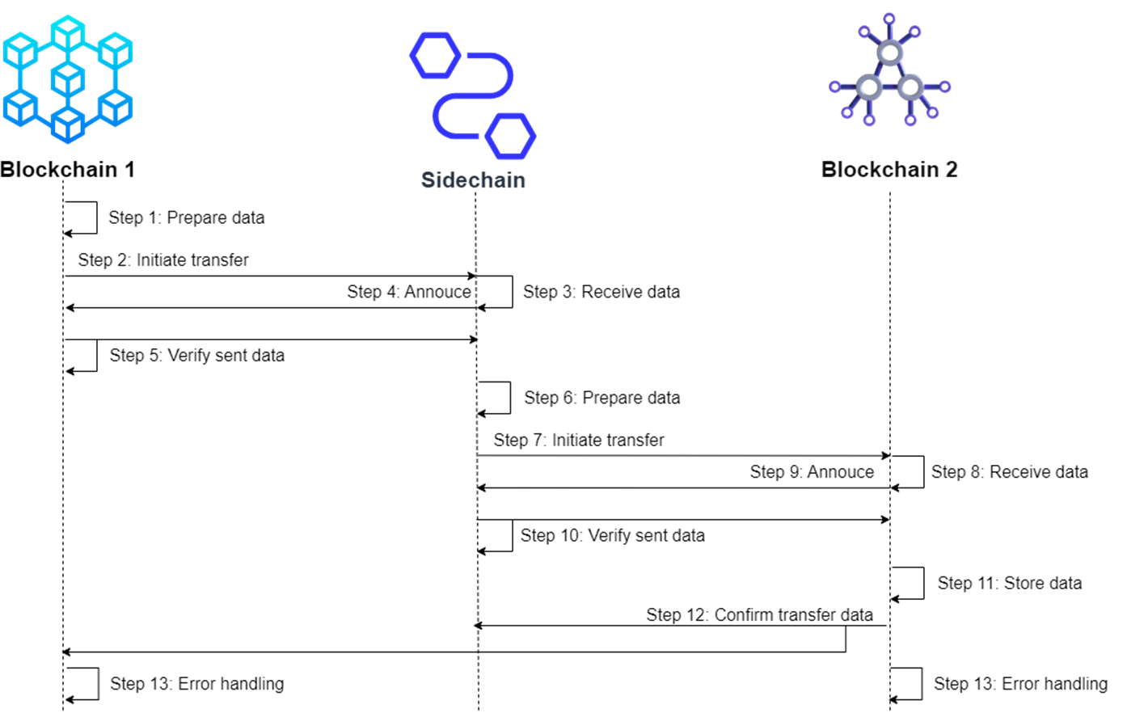
Step in transfer data

Slide 10
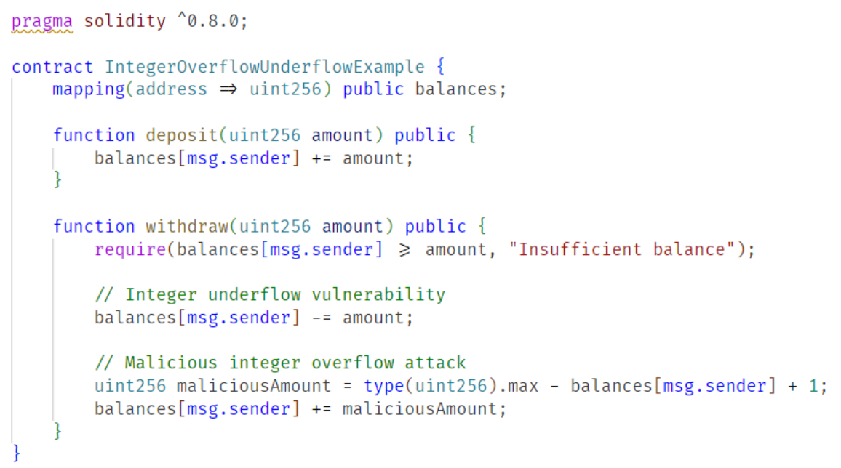
The overflow/underflow attack

Slide 11
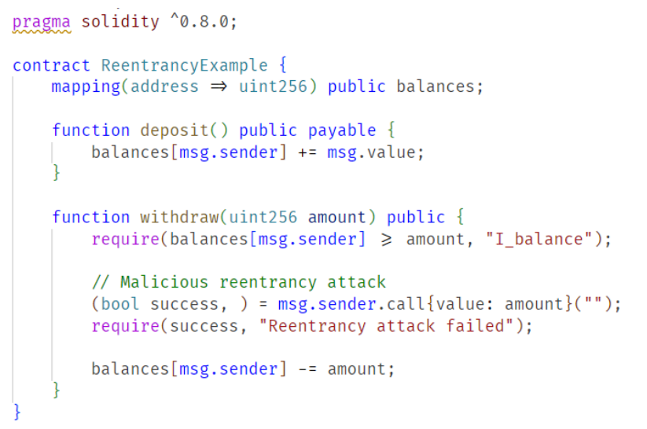
The Reentrancy attack

Slide 12
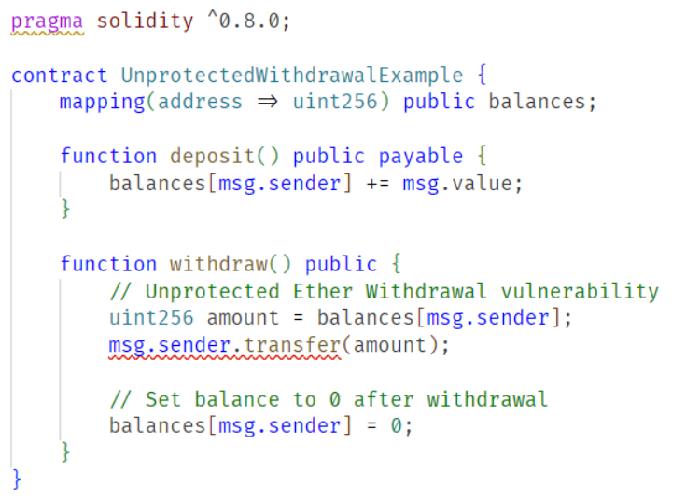
The Unprotected Ether Withdrawal attack

Slide 13
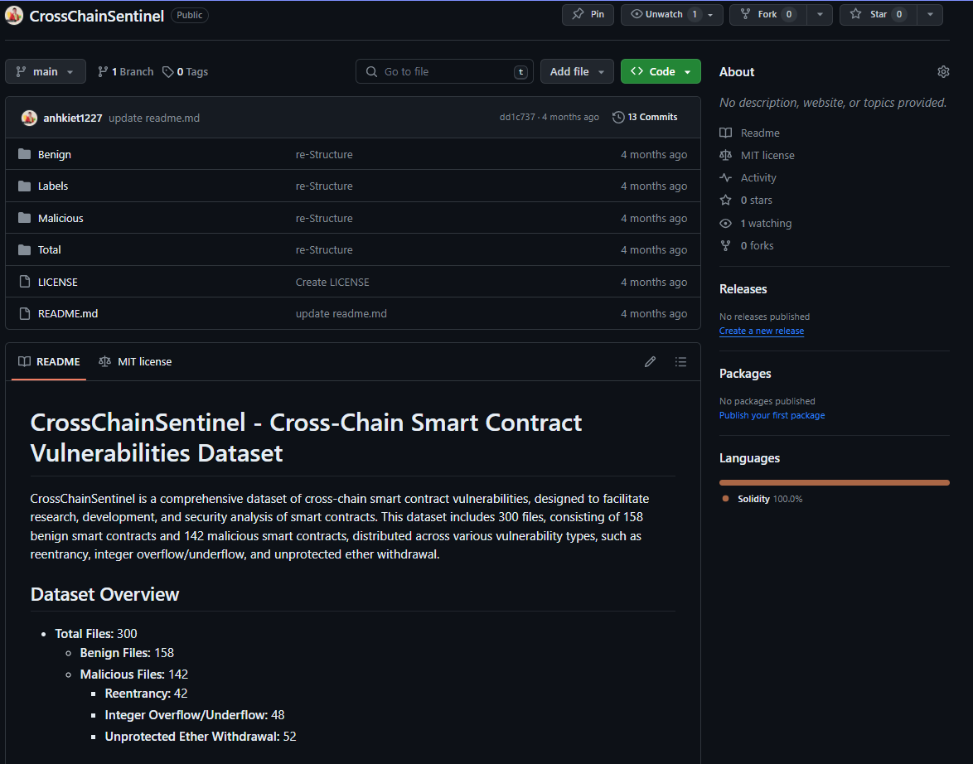
Dataset

Slide 14
Implementation
Section 03

Slide 15
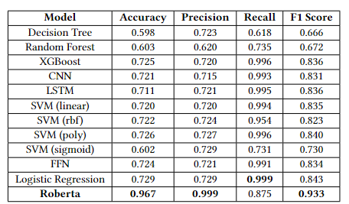
Comparative Analysis - Performance of Machine Learning Models

Slide 16
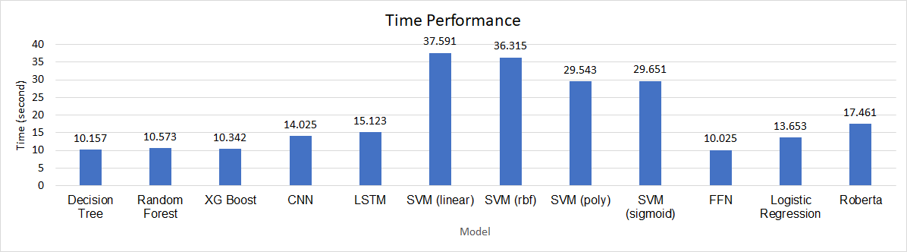
Time Performance of Machine Learning Models

Slide 17
Conclusion
Section 04

Slide 18
Conclusion
Proposed a novel system called ChainSniper for logging, scanning, and monitoring smart contracts.
Created a dataset named CrossChainSentinel containing 300 labeled smart contract samples.
Developed and evaluated various machine learning models to accurately detect malicious smart contracts

Slide 19
Future work
Enlarge CrossChainSentinel dataset to improve model generalization.
Explore advanced architectures like Transformers and transfer learning for better vulnerability identification.
Iteratively upgrade ChainSniper for fully automated pre-deployment detection of smart contract weaknesses.

Slide 20
References

Slide 21
References
[1] P. Patel and H. Patel, “Achieving a secure cloud storage mechanism using blockchain technology,” p. 130–142, 2023. [Online]. Available: http://dx.doi.org/10.7763/IJCTE.2023.V15.1342
[2] M. Kumarathunga, R. N. Calheiros, and A. Ginige, “Sustainable microfinance outreach for farmers with blockchain cryptocurrency and smart contracts,” p. 9–14, 2022. [Online]. Available: http://dx.doi.org/10. 7763/IJCTE.2022.V14.1304
[3] T. Xie, J. Zhang, Z. Cheng, F. Zhang, Y. Zhang, Y. Jia, D. Boneh, and D. Song, “zkbridge: Trustless cross-chain bridges made practical,” in Proceedings of the 2022 ACM SIGSAC Conference on Computer and Communications Security, 2022, pp. 3003–3017.
[4] P. Han, Z. Yan, W. Ding, S. Fei, and Z. Wan, “A survey on cross-chain technologies,” Distributed Ledger Technologies: Research and Practice, vol. 2, no. 2, pp. 1–30, 2023.
[5] Y. Hei, D. Li, C. Zhang, J. Liu, Y. Liu, and Q. Wu, “Practical agentchain: A compatible cross-chain exchange system,” Future Generation Computer Systems, vol. 130, pp. 207–218, 2022.
[6] R. Lan, G. Upadhyaya, S. Tse, and M. Zamani, “Horizon: A gasefficient, trustless bridge for cross-chain transactions,” arXiv preprint arXiv:2101.06000, 2021
[7] K. Qin and A. Gervais, “An overview of blockchain scalability, interoperability and sustainability,” Hochschule Luzern Imperial College London Liquidity Network, pp. 1–15, 2018.

Slide 22
References
[8] T. Hardjono, “Blockchain gateways, bridges and delegated hash-locks,” arXiv preprint arXiv:2102.03933, 2021.
[9] A. Singh, K. Click, R. M. Parizi, Q. Zhang, A. Dehghantanha, and K.-K. R. Choo, “Sidechain technologies in blockchain networks: An examination and state-of-the-art review,” Journal of Network and Computer Applications, vol. 149, p. 102471, 2020.
[10] M. H. Miraz and D. C. Donald, “Atomic cross-chain swaps: development, trajectory and potential of non-monetary digital token swap facilities,” arXiv preprint arXiv:1902.04471, 2019. Proceedings 6. Springer, 2017, pp. 164–186. [14] S. Wang, Y. Yuan, X. Wang, J. Li, R. Qin, and F.-Y. Wang, “An overview of smart contract: architecture, applications, and future trends,” in 2018 IEEE Intelligent Vehicles Symposium (IV). IEEE, 2018, pp. 108–113.
11] J. Zhang, J. Gao, Y. Li, Z. Chen, Z. Guan, and Z. Chen, “Xscope: Hunting for cross-chain bridge attacks,” in Proceedings of the 37th IEEE/ACM International Conference on Automated Software Engineering, 2022, pp. 1–4.
[12] S. Sayeed, H. Marco-Gisbert, and T. Caira, “Smart contract: Attacks and protections,” IEEE Access, vol. 8, pp. 24 416–24 427, 2020.
[13] N. Atzei, M. Bartoletti, and T. Cimoli, “A survey of attacks on ethereum smart contracts (sok),” in Principles of Security and Trust: 6th International Conference, POST 2017, Held as Part of the European Joint Conferences on Theory and Practice of Software, ETAPS 2017, Uppsala, Sweden, April 22-29, 2017, Proceedings 6. Springer, 2017, pp. 164–186.

Slide 23
References
[14] S. Wang, Y. Yuan, X. Wang, J. Li, R. Qin, and F.-Y. Wang, “An overview of smart contract: architecture, applications, and future trends,” in 2018 IEEE Intelligent Vehicles Symposium (IV). IEEE, 2018, pp. 108–113
[15] T. H.-D. Huang, “Hunting the ethereum smart contract: Color-inspired inspection of potential attacks,” arXiv preprint arXiv:1807.01868, 2018.
[16] L. Zhang, W. Chen, W. Wang, Z. Jin, C. Zhao, Z. Cai, and H. Chen, “Cbgru: A detection method of smart contract vulnerability based on a hybrid model,” Sensors, vol. 22, no. 9, p. 3577, 2022.
[17] E. Lai and W. Luo, “Static analysis of integer overflow of smart contracts in ethereum,” in Proceedings of the 2020 4th International Conference on Cryptography, Security and Privacy, 2020, pp. 110–115.
[18] M. Staderini, C. Palli, and A. Bondavalli, “Classification of ethereum vulnerabilities and their propagations,” in 2020 Second International Conference on Blockchain Computing and Applications (BCCA). IEEE, 2020, pp. 44– 51.
[19] H. Mao, T. Nie, H. Sun, D. Shen, and G. Yu, “A survey on cross-chain technology: Challenges, development, and prospect,” IEEE Access, 2022.
[20] M. Rodler, W. Li, G. O. Karame, and L. Davi, “Sereum: Protecting existing smart contracts against re-entrancy attacks,” arXiv preprint arXiv:1812.05934, 2018.

Slide 24
References
[21] P. Praitheeshan, L. Pan, J. Yu, J. Liu, and R. Doss, “Security analysis methods on ethereum smart contract vulnerabilities: a survey,” arXiv preprint arXiv:1908.08605, 2019.
[22] S. S. Kushwaha, S. Joshi, D. Singh, M. Kaur, and H.-N. Lee, “Systematic review of security vulnerabilities in ethereum blockchain smart contract,” IEEE Access, vol. 10, pp. 6605–6621, 2022.
[23] J.-W. Liao, T.-T. Tsai, C.-K. He, and C.-W. Tien, “Soliaudit: Smart contract vulnerability assessment based on machine learning and fuzz testing,” in 2019 Sixth International Conference on Internet of Things: Systems, Management and Security (IOTSMS). IEEE, 2019, pp. 458–465.
[24] S. Badillo, B. Banfai, F. Birzele, I. I. Davydov, L. Hutchinson, T. KamThong, J. Siebourg-Polster, B. Steiert, and J. D. Zhang, “An introduction to machine learning,” Clinical pharmacology & therapeutics, vol. 107, no. 4, pp. 871–885, 2020.
[25] M. Krichen, “Strengthening the security of smart contracts through the power of artificial intelligence,” Computers, vol. 12, no. 5, p. 107, 2023.
[26] Y. Xu, G. Hu, L. You, and C. Cao, “A novel machine learning-based analysis model for smart contract vulnerability,” Security and Communication Networks, vol. 2021, pp. 1–12, 2021.

Slide 25
References
[27] T. Haugum, B. Hoff, M. Alsadi, and J. Li, “Security and privacy challenges in blockchain interoperability-a multivocal literature review,” in Proceedings of the 26th International Conference on Evaluation and Assessment in Software Engineering, 2022, pp. 347–356.
[28] D. He, Z. Deng, Y. Zhang, S. Chan, Y. Cheng, and N. Guizani, “Smart contract vulnerability analysis and security audit,” IEEE Network, vol. 34, no. 5, pp. 276–282, 2020.
[29] W. Deng, H. Wei, T. Huang, C. Cao, Y. Peng, and X. Hu, “Smart contract vulnerability detection based on deep learning and multimodal decision fusion,” Sensors, vol. 23, no. 16, p. 7246, 2023.
[30] J. Huang, K. Zhou, A. Xiong, and D. Li, “Smart contract vulnerability detection model based on multi-task learning,” Sensors, vol. 22, no. 5, p. 1829, 2022
[31] B. Jiang, Y. Liu, and W. K. Chan, “Contractfuzzer: Fuzzing smart contracts for vulnerability detection,” in Proceedings of the 33rd ACM/IEEE International Conference on Automated Software Engineering, 2018, pp. 259–269.
[32] R. M. Parizi, A. Dehghantanha, K.-K. R. Choo, and A. Singh, “Empirical vulnerability analysis of automated smart contracts security testing on blockchains,” arXiv preprint arXiv:1809.02702, 2018

Slide 26

Thank you for listening

